Slide 1
Pace is moving to
Windows 10!
The latest Microsoft Desktop interface

Slide 2
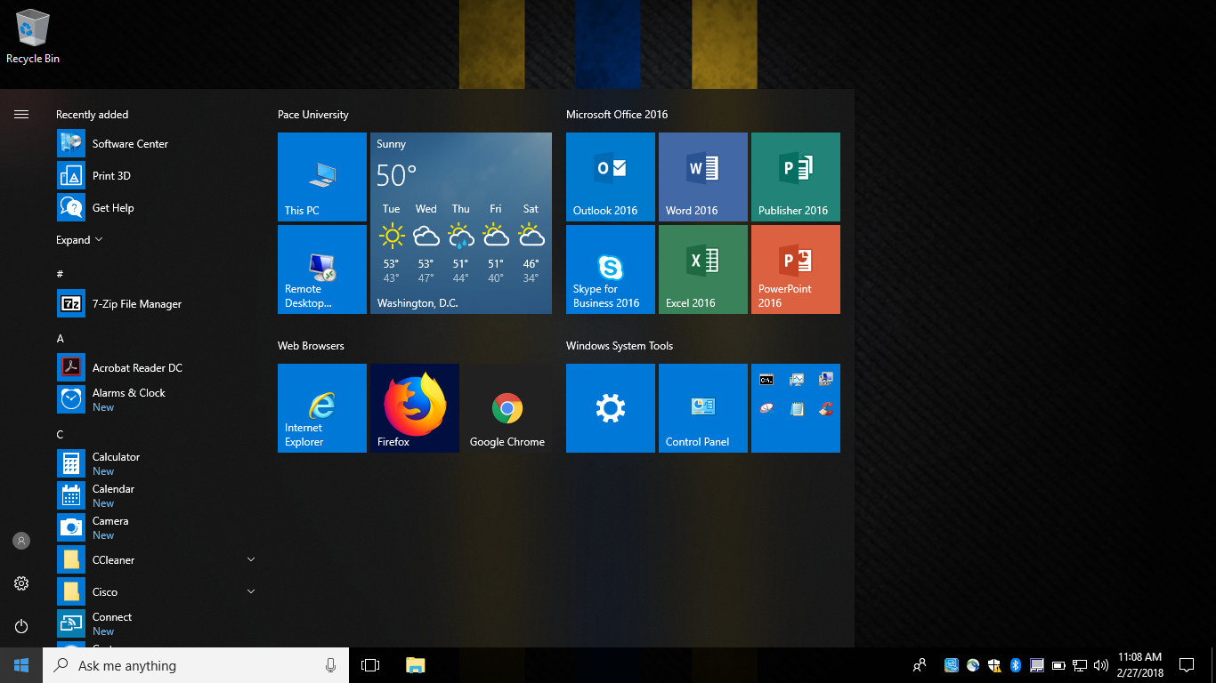
Pace is moving to Windows 10!
New Start Menu
Sleek new look
Faster scrolling
Faster search
Tile shortcuts

Slide 3
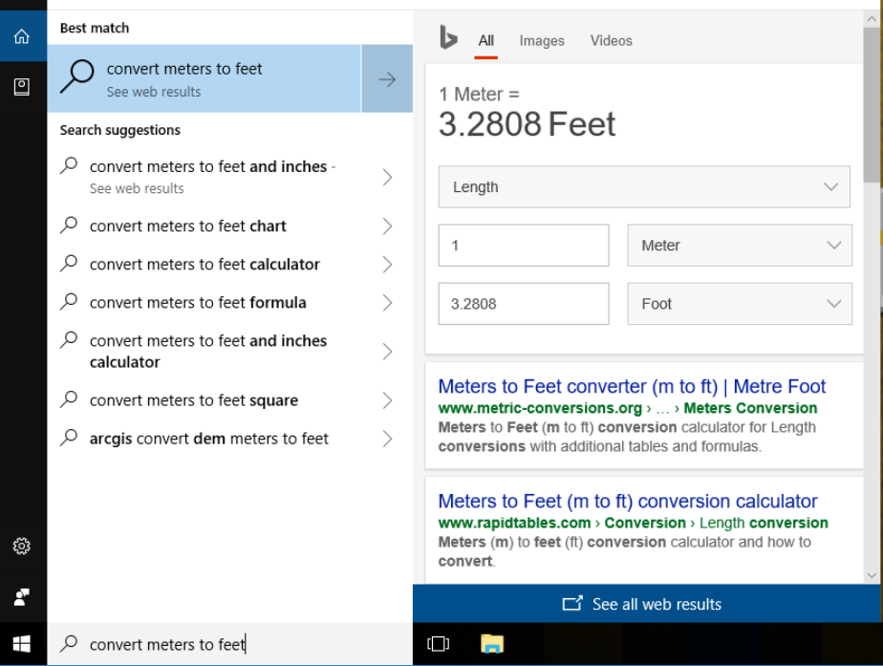
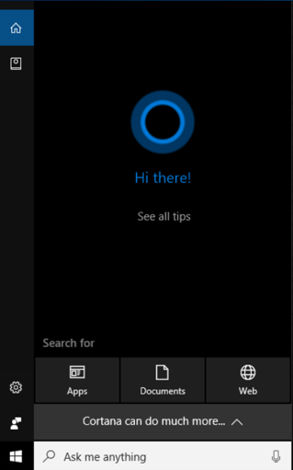
Pace is moving to Windows 10!
Cortana Assistant
Get answers quickly
In-depth search detail

Slide 4
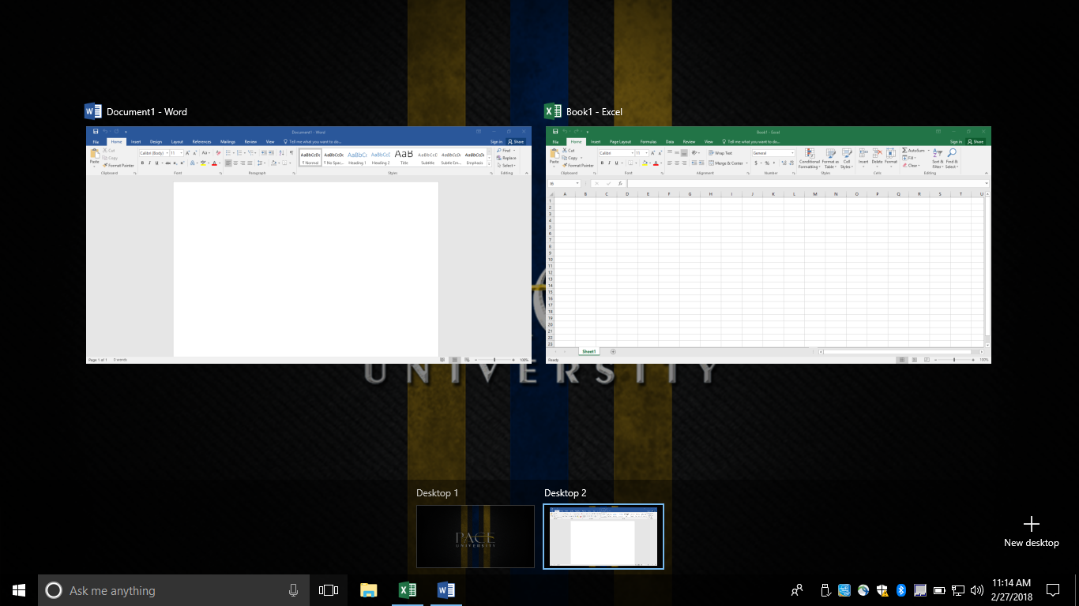
Pace is moving to Windows 10!
Virtual Desktops
Windows Key + Tab
Avoid clutter
Give apps their own desktop
Multiple full-screen apps

Slide 5
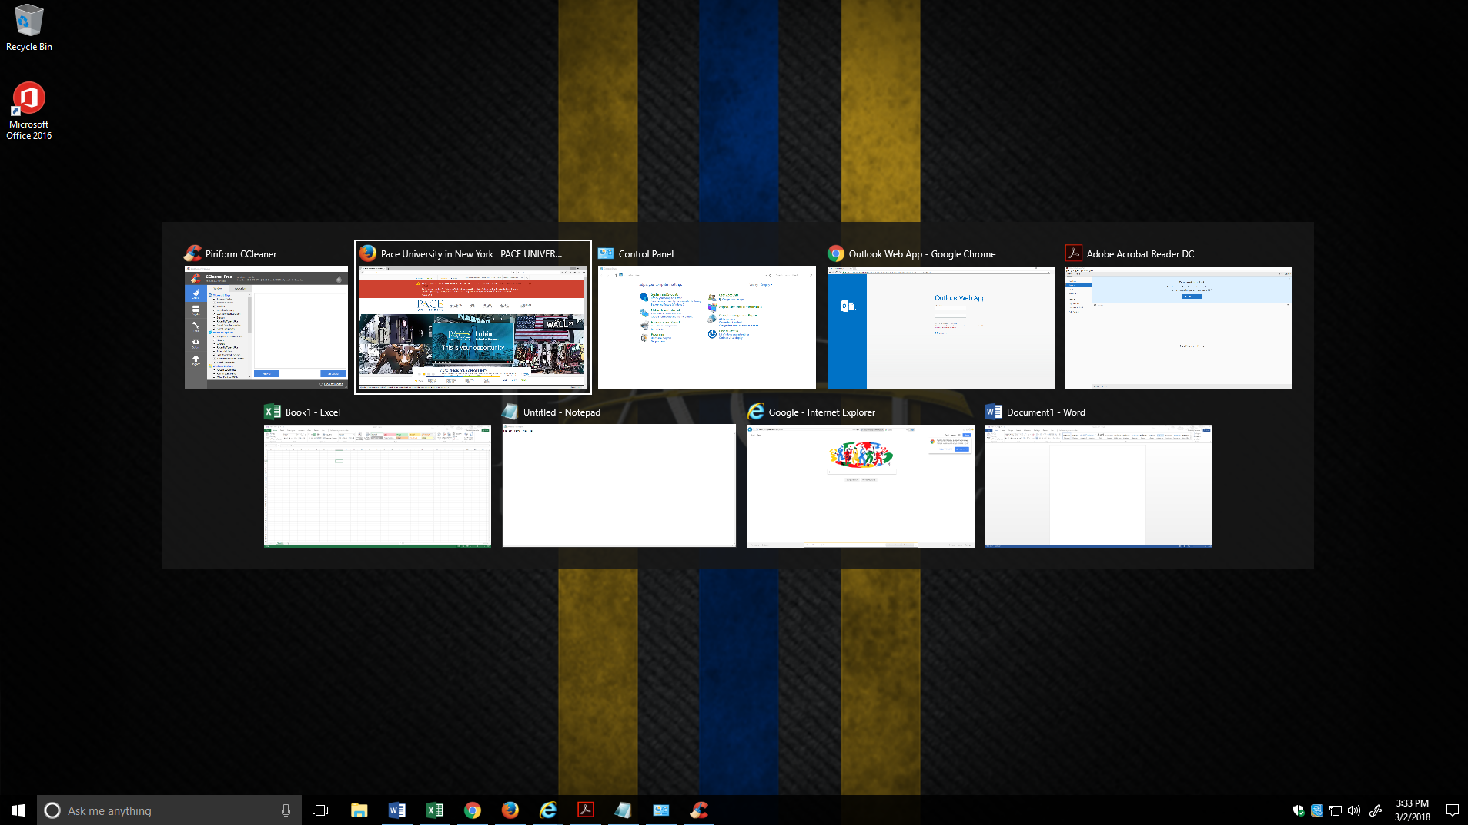
Pace is moving to Windows 10!
Task Switcher
ALT + TAB
Quickly move between apps
Less minimizing and maximizing windows

Slide 6
Pace is moving to Windows 10!
Starting FY18: All new & redistributed machines include Windows 10
Summer ‘18: All Lab and Classroom PCs to be upgraded to Windows 10
For more info, please visit www.pace.edu/windows10

