Slide 1
New Program Submissions
Instructions and Workflow including Important FY23 Submission Dates
Updated 9/5/20

Slide 2
Instructions
Internal Review Grid (IRG)
To be used for the review and approval for ALL ACADEMIC PROGRAM SUBMISSIONS
The Internal Review Grid provides a comprehensive summary of the review and approval steps needed for:
All undergraduate and graduate programs, courses, and non-credit bearing programs
Indicates which new programs and program revisions are required to be submitted to NYS for approval
2. Business Case Proposal and Financial Proforma
To be completed for ONLY THOSE ACADEMIC PROGRAMS REQUIRING new financial resources (eg, faculty, adjuncts, capital, space)
These forms provide a comprehensive summary of the market demand and financial resources needed for the new program submission:
Business Case Proposal provides a comprehensive market study and program assessment
Financial Proforma provides a 5-year financial projection of enrollment, revenue, and profit
See Deans Council presentation dates (slide 9 )

Slide 3
Workflow Summary
Revise Program Submission
New Undergraduate or Graduate Program Submission
Course Forms or Non-Credit Bearing Programs
Does this program require new financial resources (eg, faculty, adjuncts, capital, space)?
Does this program require new financial resources (faculty, adjuncts, capital, space)?
Does the course have a proposed area of knowledge (AOK) designation?
If not, complete the necessary steps as outlined in the Internal Review Grid (IRG) on slides, 5-7.
If yes, complete the necessary steps as outlined in the Internal Review Grid (IRG) on slides, 5-7.
Prepare the Business Case Proposal and Financial Proforma as described on slide 8.
Note important FY23 (Fall 2022/ Spring 2023) submission deadlines and presentation dates to Deans Council as described on slides 9.
If not, complete the necessary steps as outlined in the Internal Review Grid (IRG) on slides, 5-6.
If yes, complete the necessary steps as outlined in the Internal Review Grid (IRG) on slides, 5-6.
Prepare the Business Case Proposal and Financial Proforma as described on slide 8.
Note important FY23 (Fall 2022/ Spring 2023) submission deadlines and presentation dates to Deans Council as described on slide 9.
If not, complete the necessary steps as outlined in the Internal Review Grid (IRG) on slide 7.
If yes, complete the necessary steps for AOK designation as outlined in the Internal Review Grid (IRG) on slide 7.
Follow the necessary steps for a new or course change procedure.

Slide 4
1. Internal Review Grid (IRG)
The Internal Review Grid provides a comprehensive summary of the review and approval steps needed for all undergraduate and graduate programs, courses, and non-credit bearing programs
The Internal Review Grid indicates which new programs and program changes need to go to New York State for approval
Please note that the IRG was approved by BOTH the NYCFC and Westchester FC on 2/5/20 & 2/7/20, respectively. Please note that Footnote #6 was added on 6/26/20 to conform to new Middle States Accreditation Requirements.

Slide 5
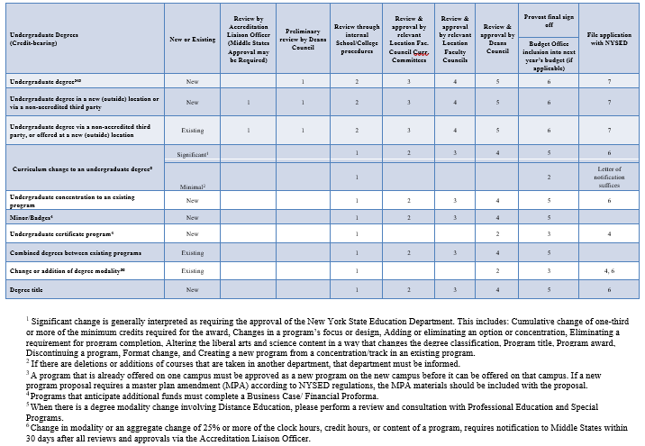
IRG – UG Degrees

Slide 6
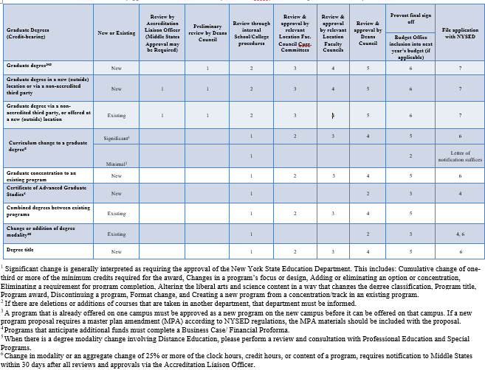
IRG – GRAD Degrees

Slide 7
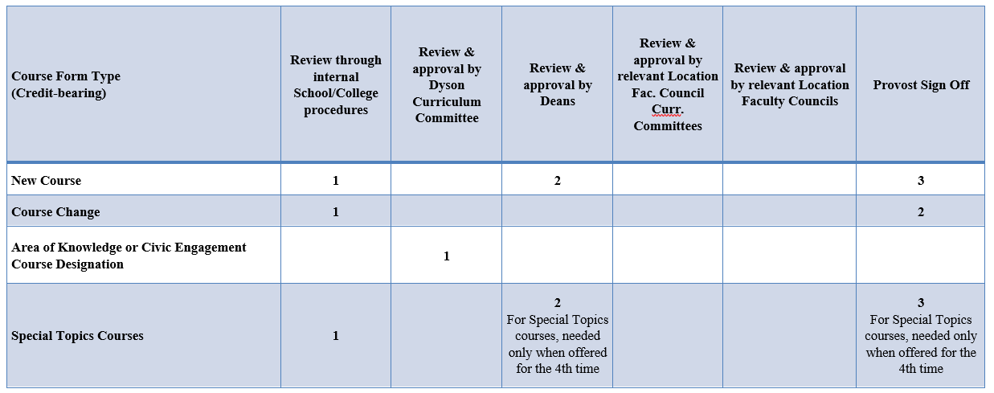
IRG – Other

Slide 8
2. Business Case Proposal & Financial Proforma
The following documents should be completed for all academic program submissions requiring new financial resources (eg, faculty, adjuncts, capital, space):
Business Case Program Proposal - a conclusive narrative of the program, including a comprehensive market study and program assessment
Financial Proforma Model - A 5-year financial projection of enrollment, revenue and profit (see separate files for undergraduate and graduate/special programs)
These documents will be presented at Deans Council (presentation dates on slide 9)
Please note that the Business Case Proposal and Financial Proforma templates can be found on the Pace website at www.pace.edu/PROVOST (and select Polices and Forms)

Slide 9
Important Fall 2020 & Spring 2021 Dates
Please Note: This timeline ONLY applies to program submissions with new financial resource requests. All new programs requiring new financial resources must be fully approved by May 2021 for inclusion in the FY23 Budget (Fall 2022/Spring 2023).
Preliminary Review by Deans Council
Financial Aid Review Committee (FARC)
Final Review & Approval by Deans Council
Review of FY23 Business Case Program Proposals
Review of programs with special tuition pricing, scholarships, or financial aid
Review of the FY23 Financial Proformas (eg, approved Business Case Program Proposals) requesting new financial resources
April 6, 2021
December 1, 2020
Meets every Tuesday from 1:00pm-2:30pm
October 6, 2020
November 3, 2020
January 12, 2021
March 9, 2021
February 9, 2021
May 11, 2021 *if needed

Slide 10
FY23 Approval Timeline
For programs that require new financial resources, the goal of this timeline is to align the financial, operational, and human resource needs with the annual budget cycle.
April/May 2021 Proformas approved for the Fall 2022/Spring 2023 (FY23)
June 2021 Request for capital funds for FY23
July 2021 Review and approval of new faculty requests for Fall 2022 hire (FY23)
November 2021 Submission of new financial resources as part of FY23 annual budget cycle
January 2022 All new program proformas (enrollment, revenue, and expenses) included as part of the FY23 budget
June 2021 Annual Reports due with review of prior year, objectives for current year, and resources needed for new year (FY23)
Sept 2020- Mar 2021
Business Case Program Presentations to Deans Council

Slide 11
Contact Information
For questions on the NYSED approval process or Business Case Proposal and Financial Proforma, email programreview@pace.edu or call (212) 346-1956
For questions on MSCHE, email ALO@pace.edu
Please visit the Pace University website:
www.pace.edu/PROVOST (and select Polices and Forms)

